Slide 2
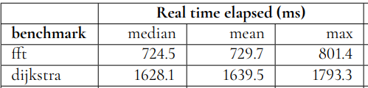
MiBench
MiBench----------->dijkstra_large.c
MiBench----------->fft

Slide 3
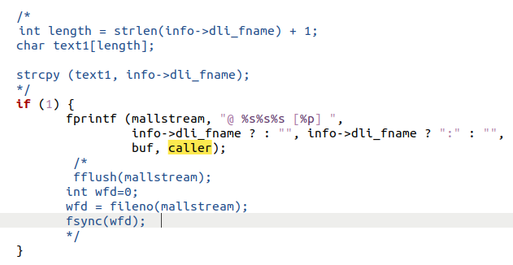
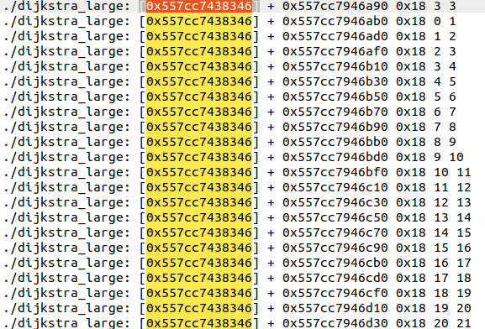
tr_where

Slide 4
tr_where

Slide 5
